Slide 1
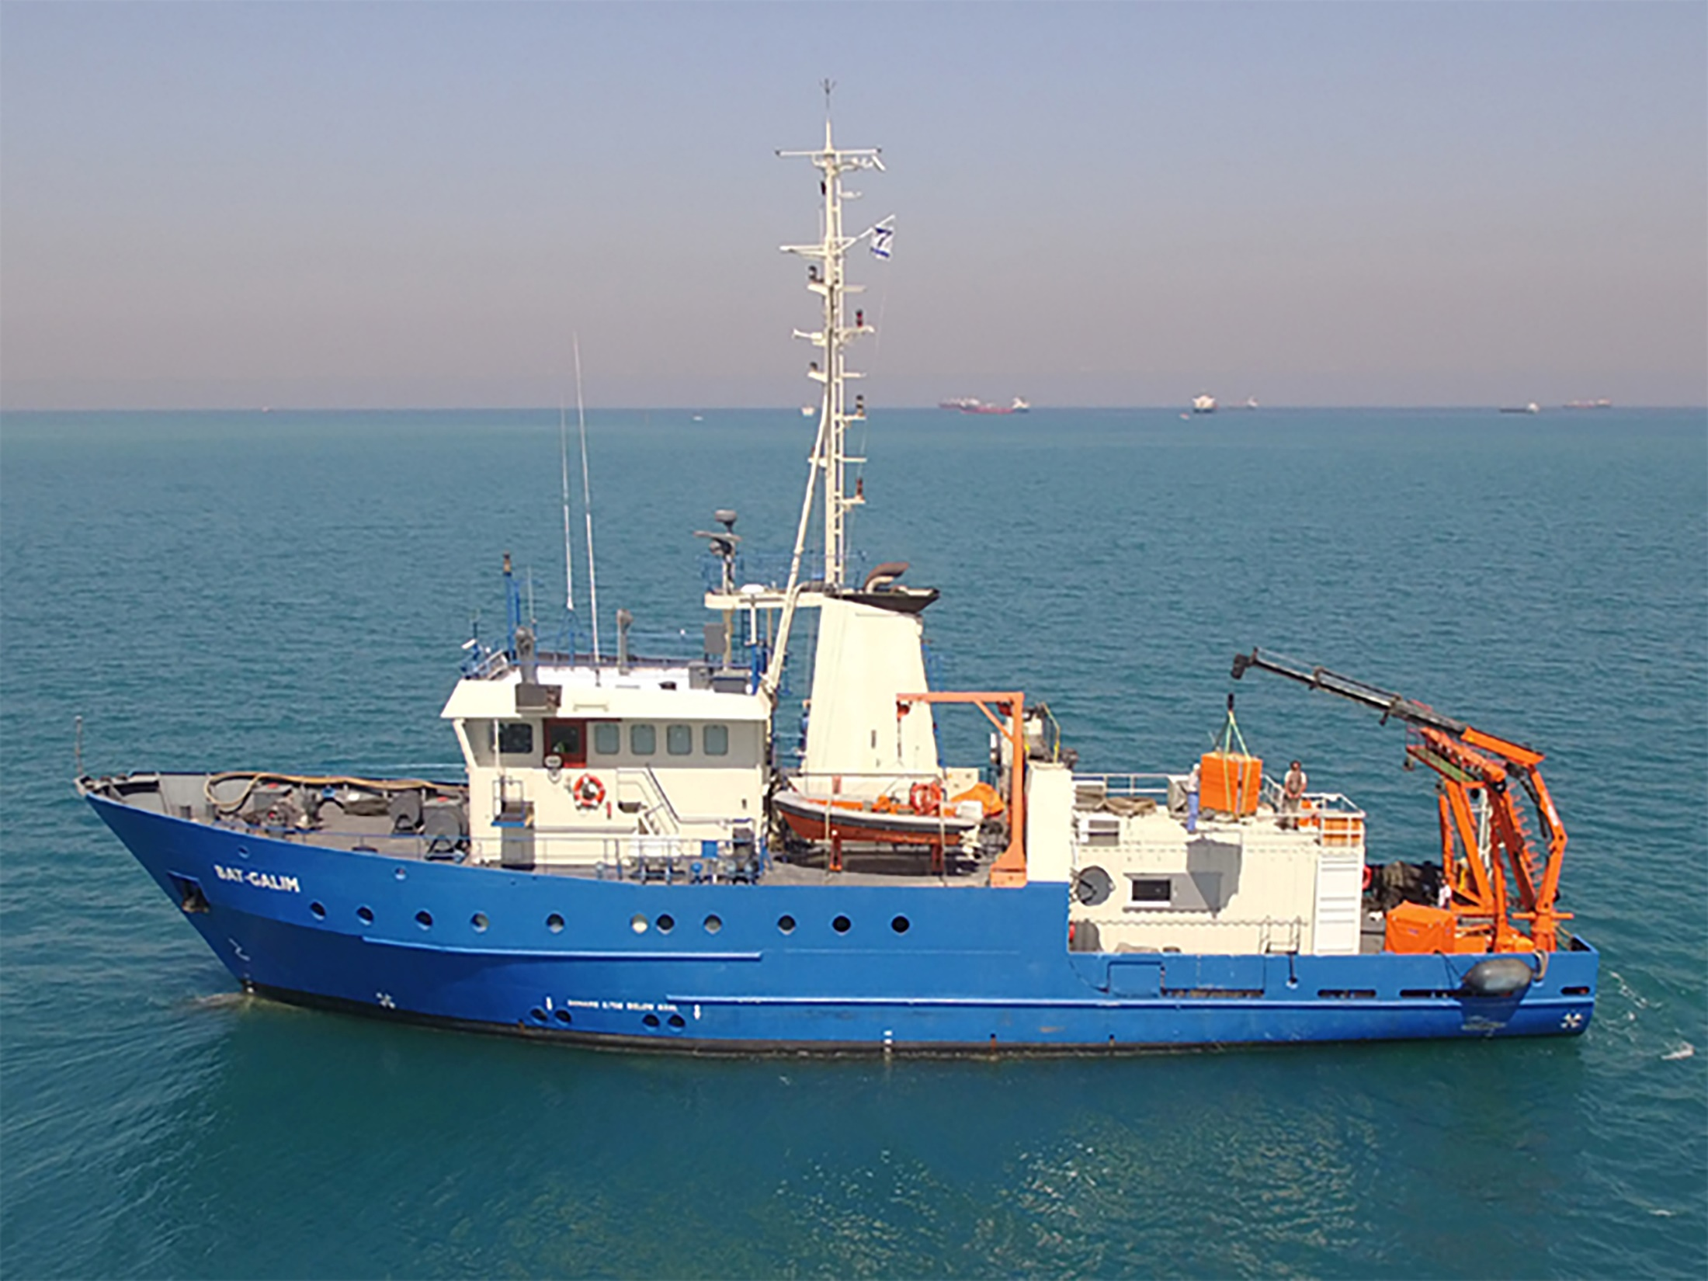
R/V Bat-Galim - a new governmental research vessel
21st ERVO Annual Meeting June 11-13 , 2019 Hamburg, Germany

Slide 2
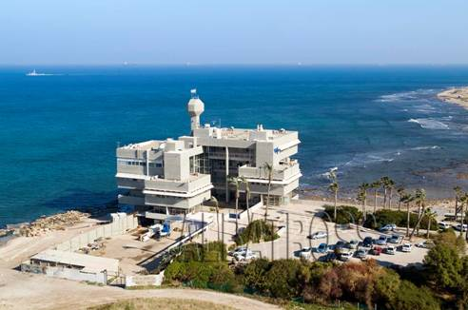
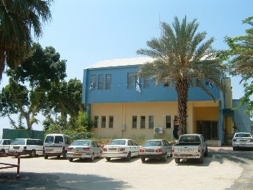
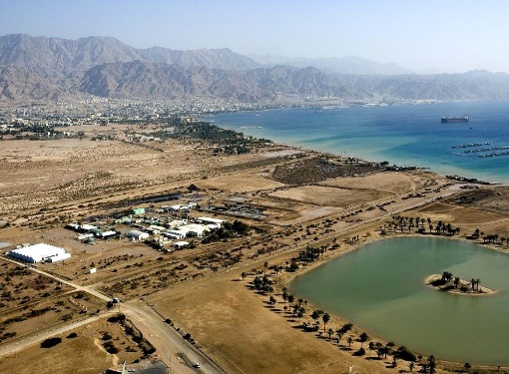
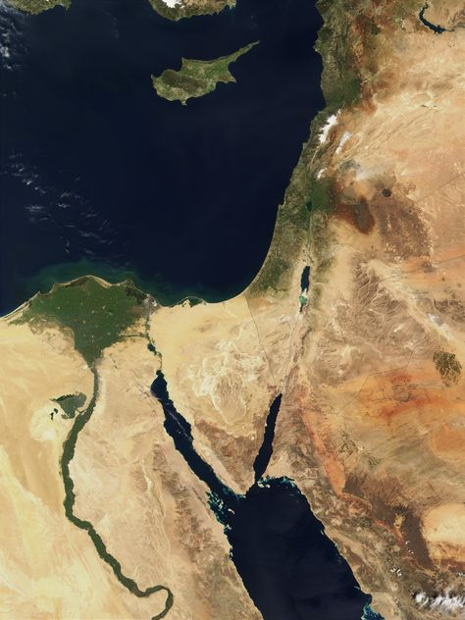
Israel Oceanographic & Limnological Research (Since 1967)
Mediterranean Sea
Sea of Galilee
Red Sea
National Institute of Oceanography - NIO
Kinneret Limnological Laboratory - KLL
National Center of
Mariculture - NCM
Annual budget: ~ $ 16 million
Staff: ~ 160 scientists (50 PhDs), engineers, technicians and support staff
~ 70 MSc. & PhD. students
~ 75 publications in scientific peer-reviewed journals and 150 Reports
~150 research projects (40 International and 25 National Funds)
> 6500 high school students (lectures, field and laboratory experiments)
E. Med. Sea
Red Sea
http://www.ocean.org.il

Slide 3
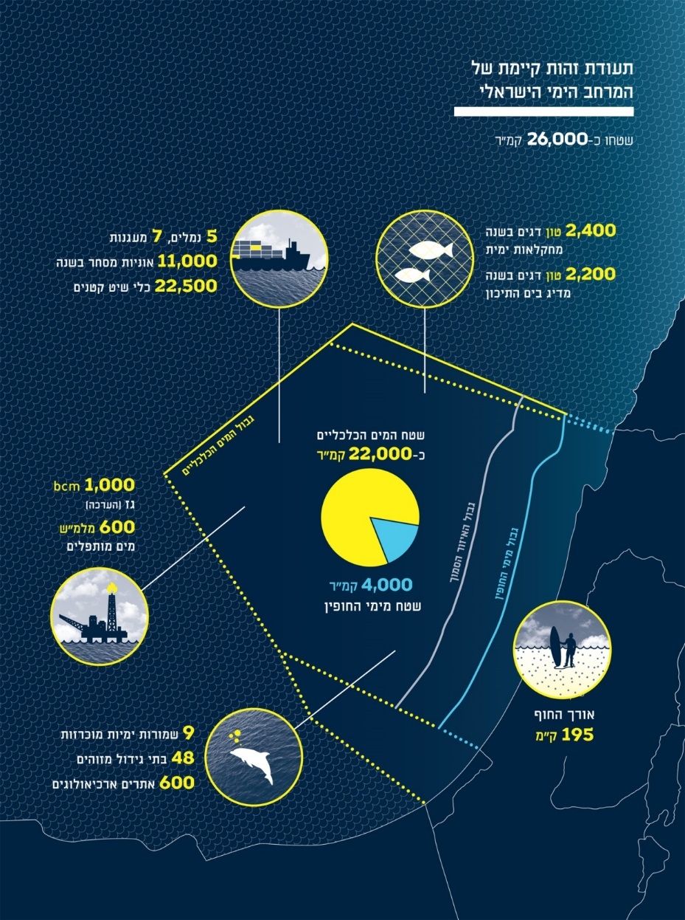
IOLR Core Activities:
Oceanographic research - physical, chemical, geological and biological;
Monitoring and assessment of human impacts on marine and coastal ecosystems and resources;
Development of Operational Oceanography -observing and modeling systems to provide timely environmental information and predictions;
Mapping, environmental risks, geo-hazards and multidisciplinary studies - marine surveys, data collection and organization of environmental data bases, process studies;
Operation of the Israel Marine Data Center as the national repository and dissemination facility for oceanographic data and data products.
Few fact on the Israeli EEZ & coastal waters
5 Power plants
5 Desalination plants , 650 mcm
(https://isramar.ocean.org.il)

Slide 4
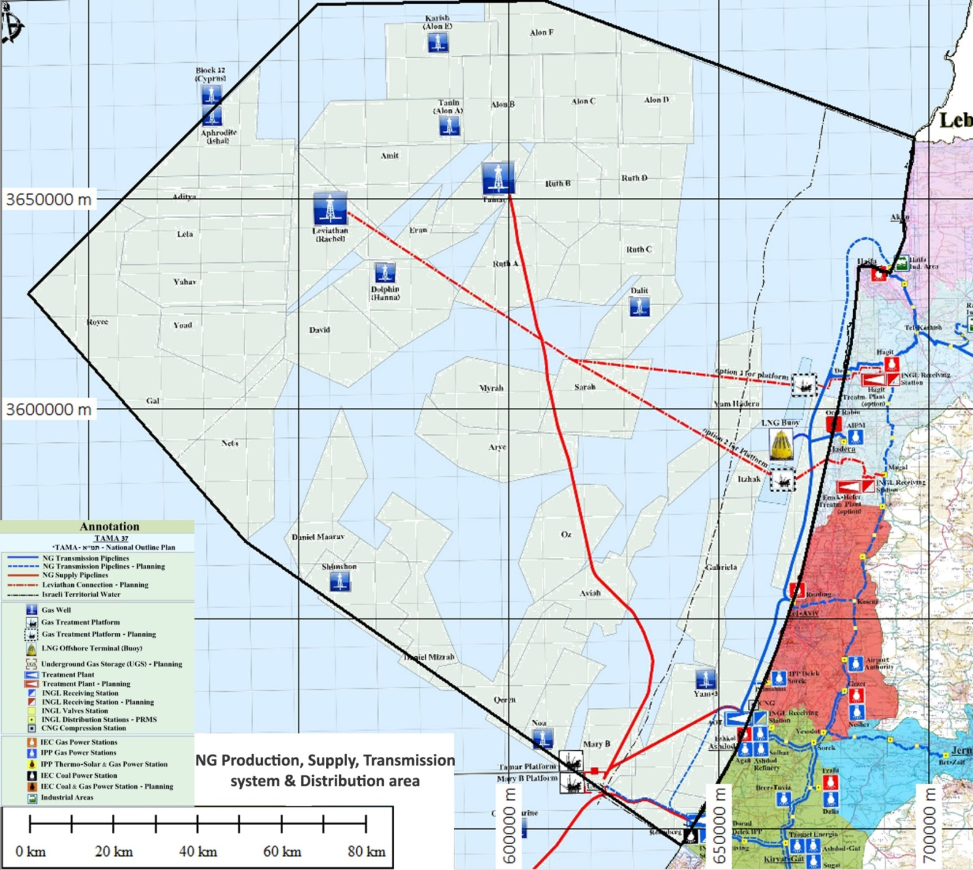
Israel Exclusive Economic Zone (EEZ)
The recent (2009) large-scale natural gas (~ 1,000 BCM) and oil discoveries in the deep sea of the Israeli EEZ stressed the need of a National Research Vessel capable of working in the deep EEZ.
On February 2012 - Governmental decision to build/purchase research vessel (budget ~ $ 5 M)
Lebanon EEZ
Cyprus EEZ
Tanin
Aphrodite
Tamar
Leviathan
Dolphin
Dalit
Egypt EEZ
Noa

Slide 5
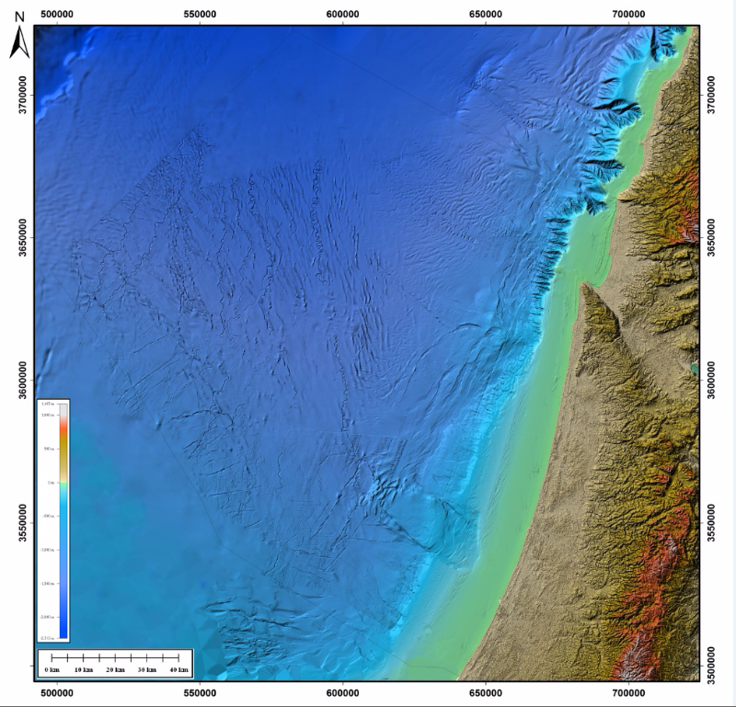
Vessel tasks
Deep sea research (Oceanography, Biology, Geophysics, Geology, Geo-chemistry)
Environmental surveys & monitoring
Geo-hazard assessment
Academic research & education
Oil-spill response
Search and recovery

Slide 6
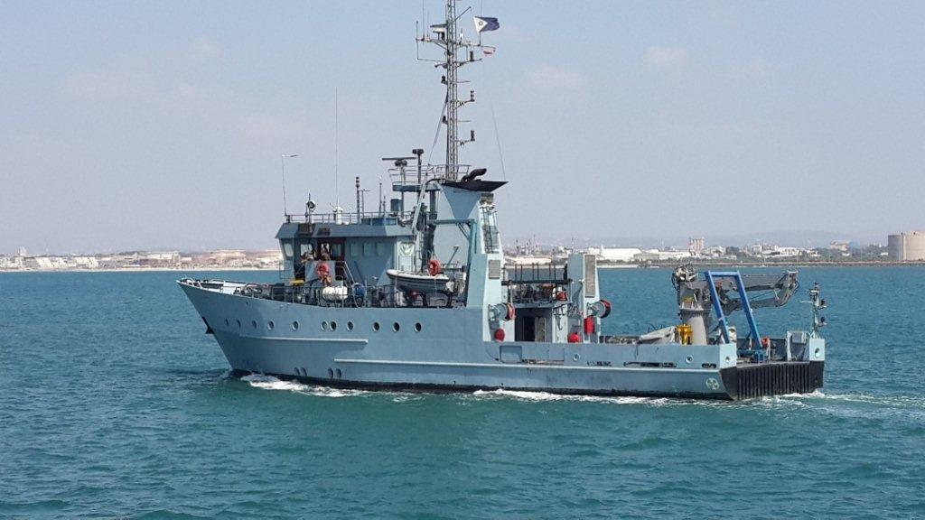
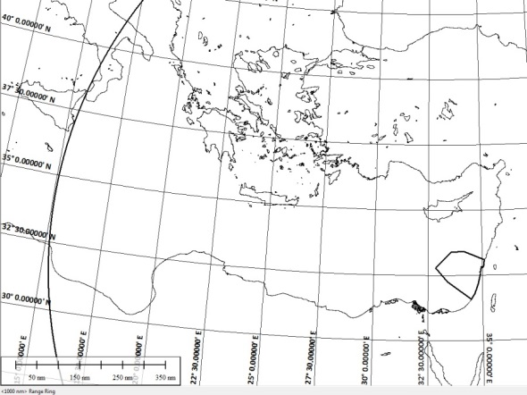
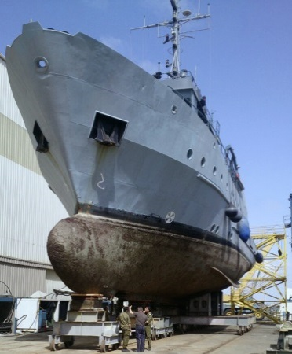
German-built Klein-Klasse support vessel
Purchased from the Israeli Navy June 1st, 2014
EEZ
1,000 nm
Hull material | Steel | Max. draft | 3.45 m | Endurance at sea | 14 days
LBP | 34.6m | FB | 3.1m | Operational range | ~ 1,000 nm
LOA | 38.55m | Max speed | 12.7 knots | Propulsion | 2X208 HP jets & single propeller
Max. displacement | 528 ton | Crew + Scientists | 14 (24)
Deutz Generators | 2X 124 kW |  |  | Propulsion system | 890 KW Deutz engine
Built: 1990

Slide 7
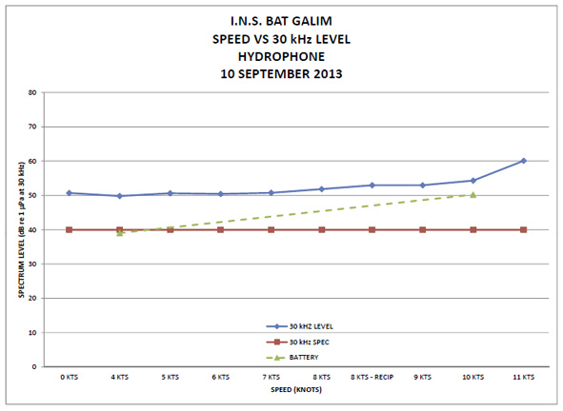
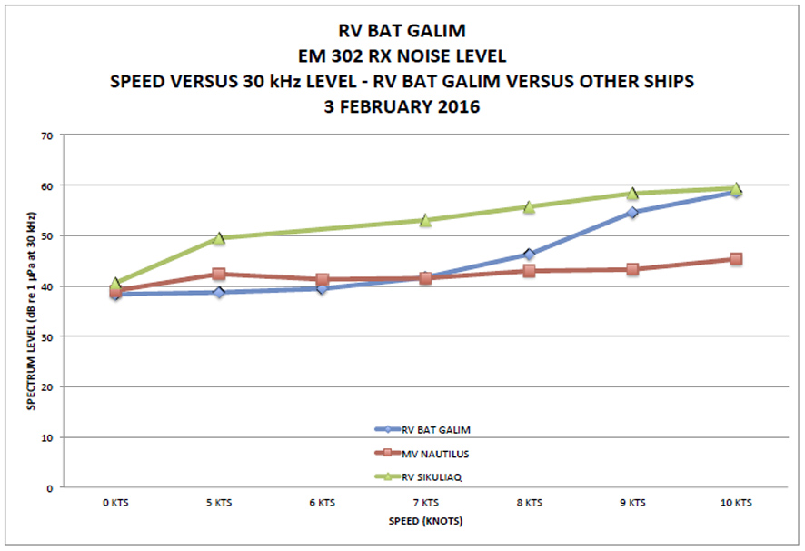
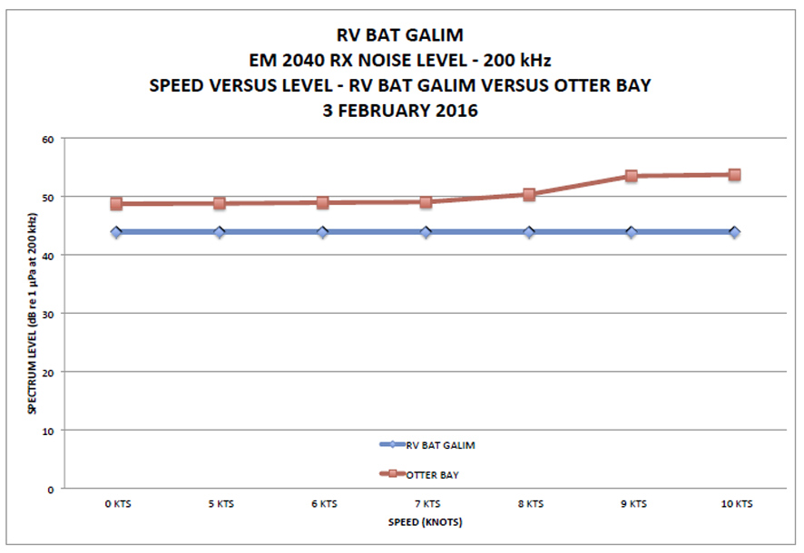
Acoustic tests - Pre. & Post Gondola installation (http://mac.unols.org/reports)
Gates Acoustic Services
30 kHz
30 kHz
50
50
40
40
dB
dB
Post
R/V Bat Galim
R/V Nautilus
R/V Sikuliaq
Pre.
The BAT GALIM was determined to be a relatively quiet platform for MBS data collection.
Propeller cavitation characteristics are good up to 8 knots and no machinery noise was noted that will impact sonar data.
Bubble sweep down impacts were not detected at any time during the acoustic test.
The acoustic levels measured during normal ship operations up to 8 knots are similar to other vessels equipped with mid-depth MBS systems
200 kHz
50
40
dB
Post
R/V Bat Galim
R/V Otter Bay

Slide 8
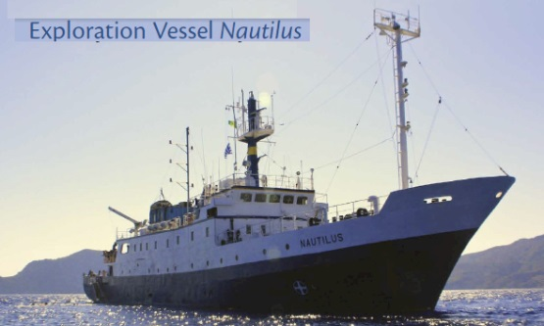
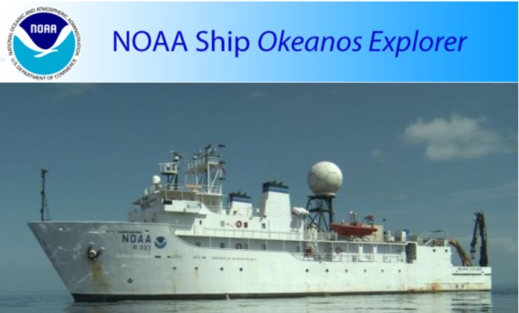
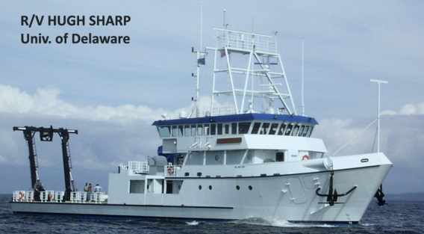
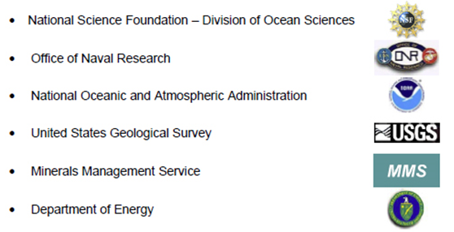
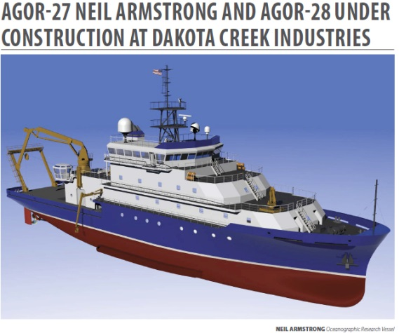
Guidelines for setting a modern Research Vessel
The refitting of the Bat Galim into a modern research vessel follows most of the guidelines set in the Science Mission Requirements (SMR) for Regional Class oceanographic vessels that were developed as part of the Academic renewal efforts by the University-National Oceanographic Laboratory System (UNOLS).

Slide 9
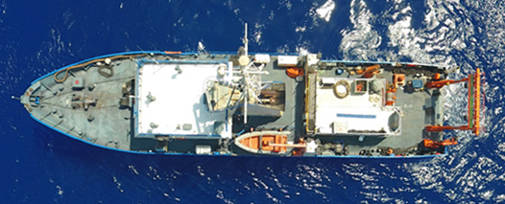
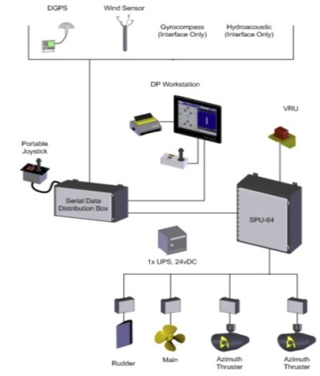
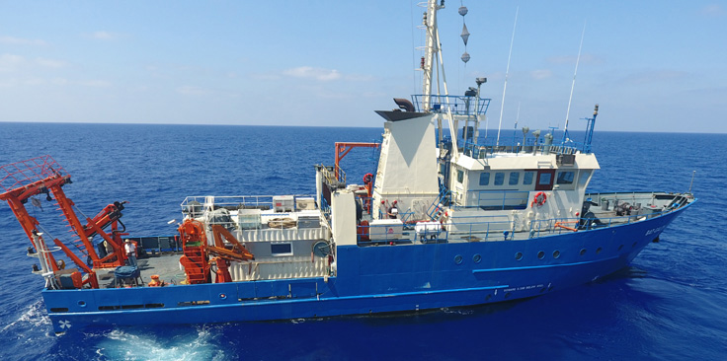
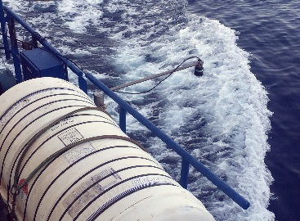
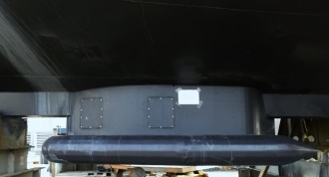
Dynamic Positioning
(June 2014-June 2016)
Refitting from military vessel to modern R/V
Labs
Telescopic A Frame
2 Cranes
winches
Acoustic (50kHz) draft meter
Gondola

Slide 10
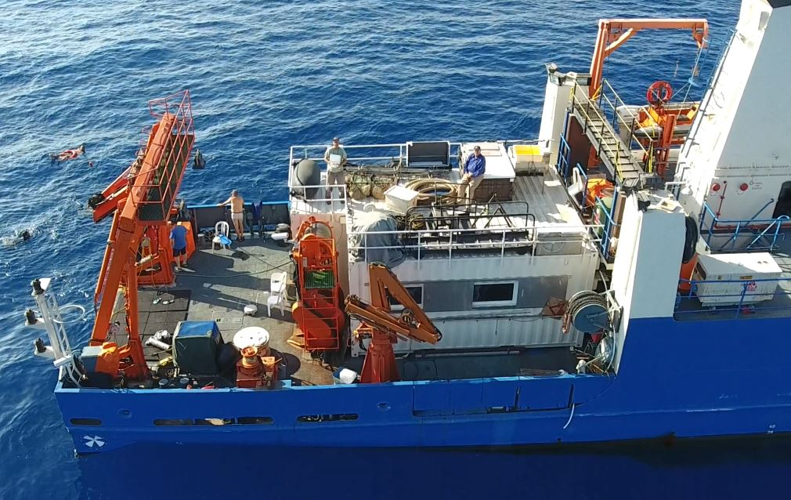
R/V Bat Galim Aft Deck (~ 14 m long X 10 m wide)
Crane: Palfinger (PK 11001 M) 11 ton⋅meter, Boom Length 10.5m
Can load 4 X 20’ containers
20’ +1.5 m WET Lab
2 Winches
20’ Dry Lab
A-Frame: Telescopic, SWL 3t at 5m, 1t at 7m (4m width), tilt 40deg.
Crane: 4 ton⋅meter, Boom Length 12.5m

Slide 11
R/V Bat Galim: Research Capabilities and other Tasks
Map the sea floor and the water column - Two multibeam systems WD 10 - 7,000 m
Map the sub-bottom in a very high resolution –CHIRP and Sparker (single & multichannel)
Sample the sub-bottom – two systems: Box Core and Piston/Gravity Core (up to 9 m long)
3-D continues current profiling – ADCP system up to 700 m below the vessel
Sample the water column – CTD and Rosetta
Data and sample analysis– Hydrographic lab/Wet/Dry/Isotope/Processing capabilities/Geophysical lab
Operate & deploy autonomous and guided equipment – AUV and ROV
Oil spill response - Spray oil dispersants & clean with oil spill skimmer
Search and recovery of missing aircraft & vessels- Pinger locator, Side scan Sonar, ROV

Slide 12
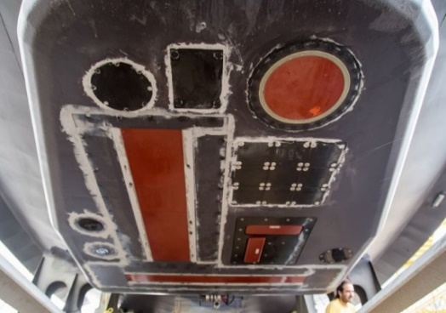
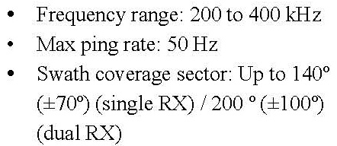
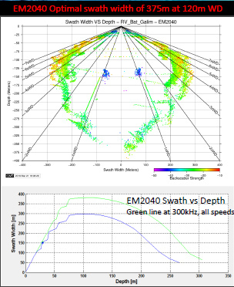
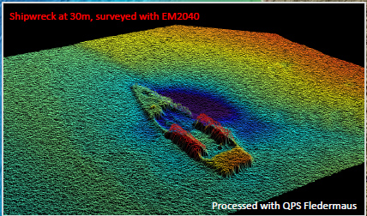
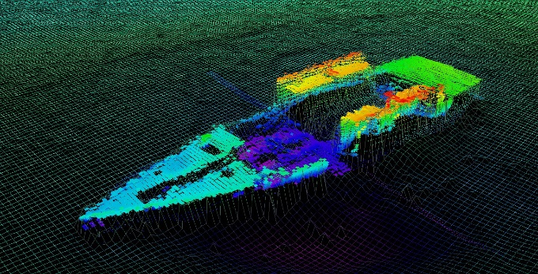
Mapping the sea floor and the water column
High resolution (WD ~< 300 m)
07 deg. TX by 0.7 deg. RX
Resolution ~ 20 cm

Slide 13
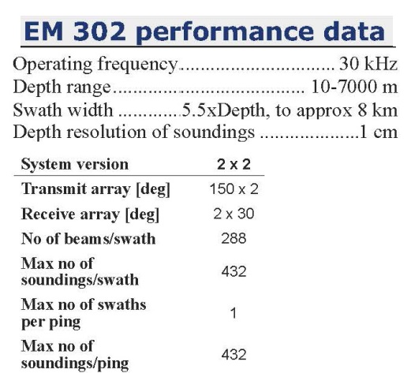
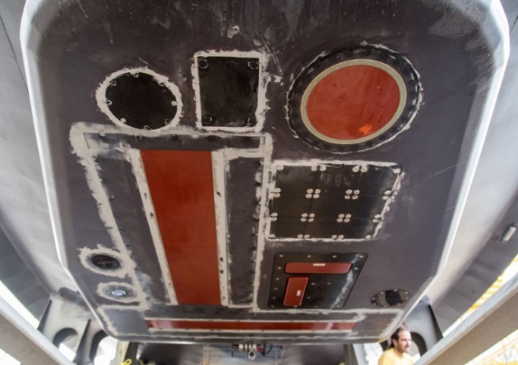
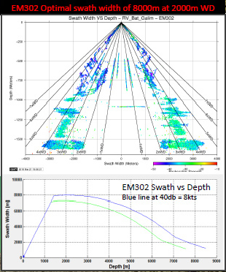
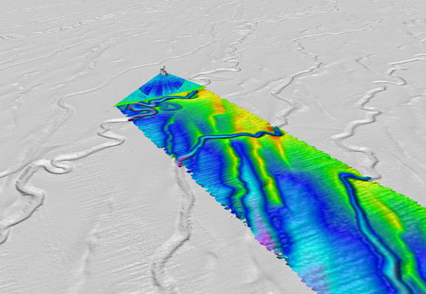
Deep water sea floor mapping (up to 7,000 m)
Transmit
2 deg. TX by 2 deg. RX
Receive
Gondola
Example of submarine deep channels (WD~ 1,700 m)

Slide 15
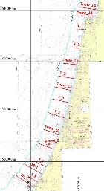
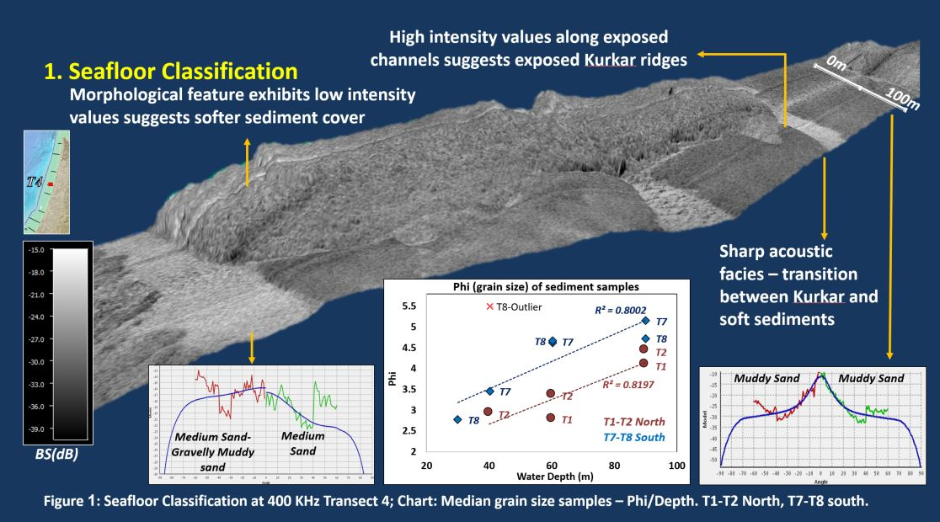
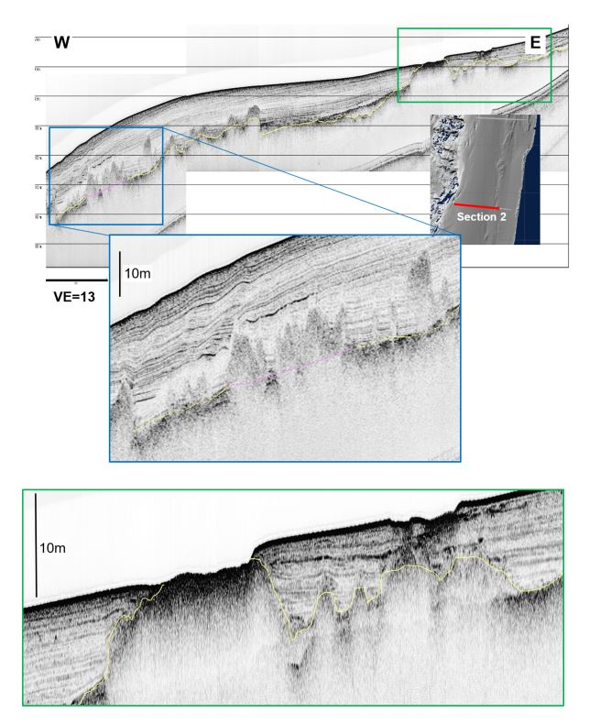
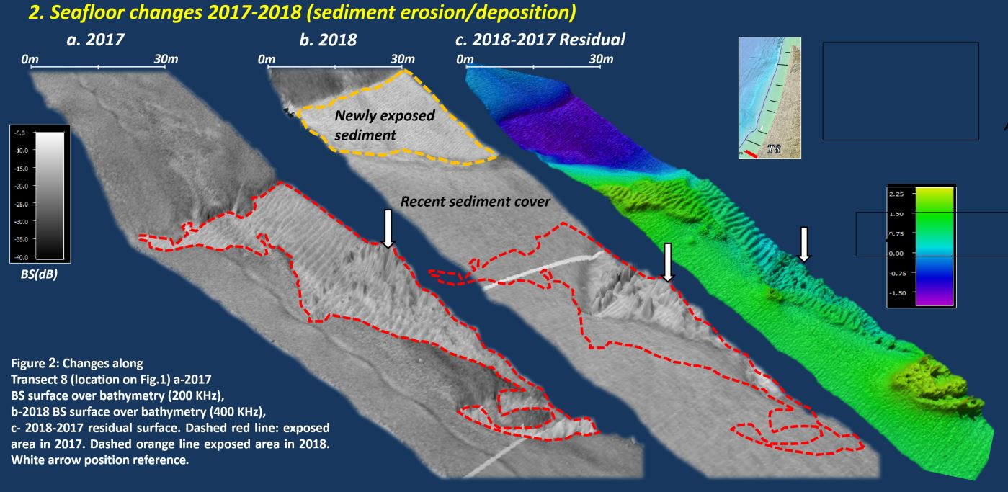
Monitoring sediment transport and morphological changes on the shelf
4. Subsurface changes

Slide 16
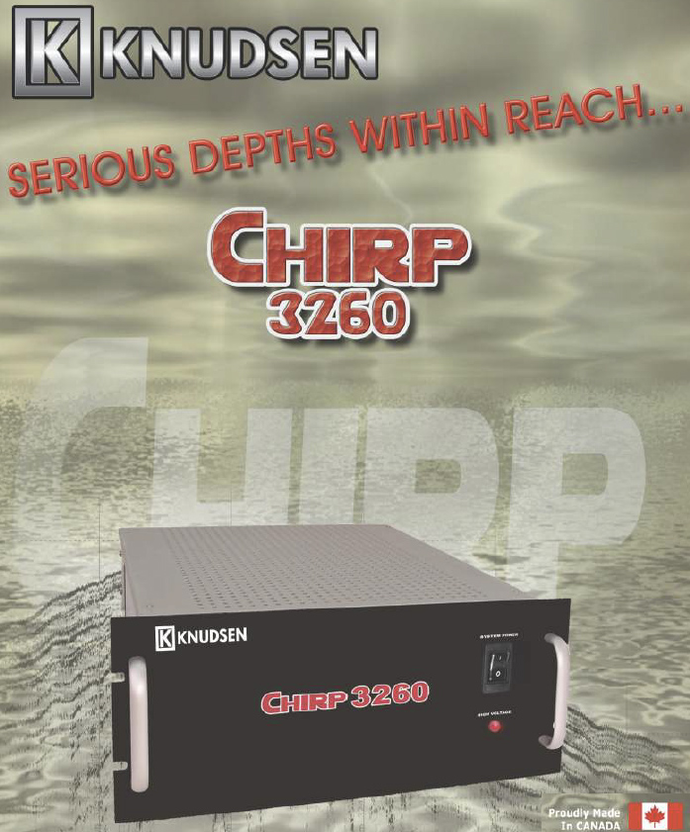
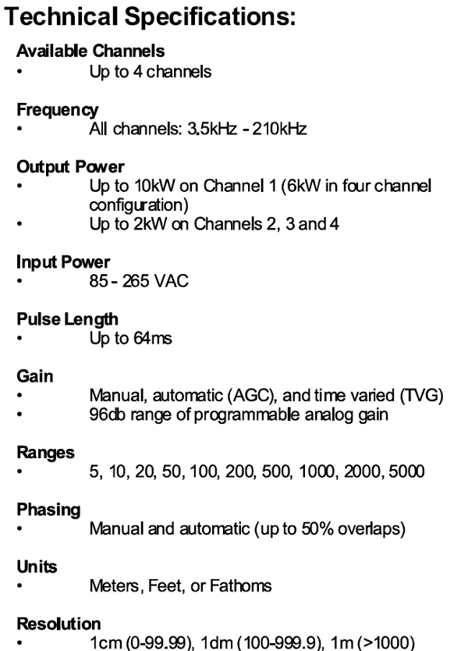
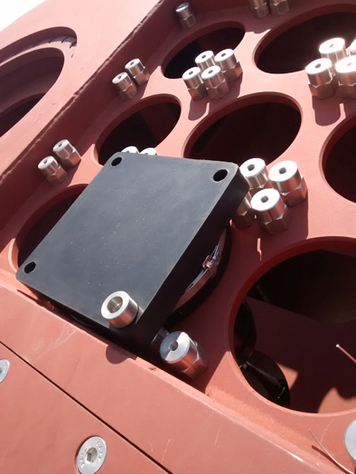
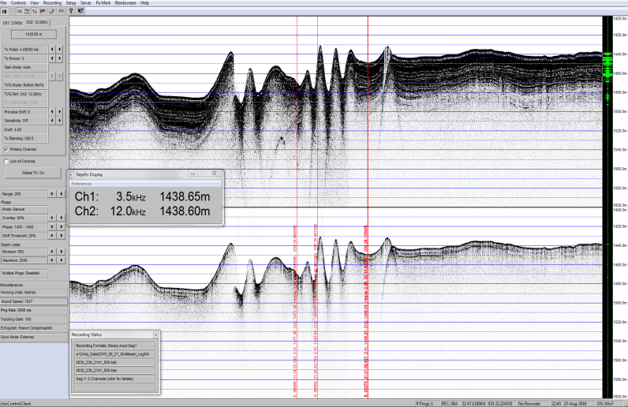
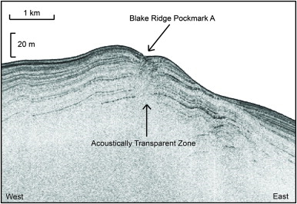
Map the sub-bottom in very high resolution – CHIRP 3260
12kHz transducer
9 X 3.5 kHz transducers
Example of submarine deep channels
(WD~ 1,440 m) in the EEZ

Slide 17
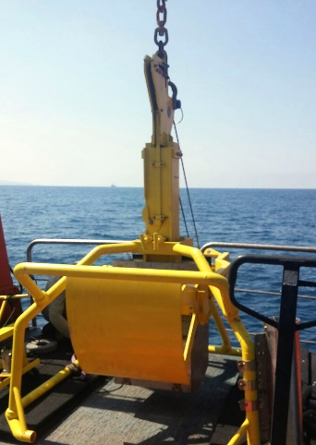
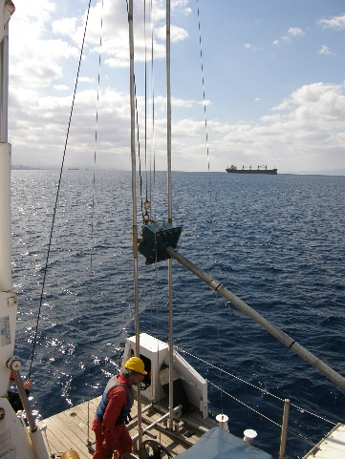
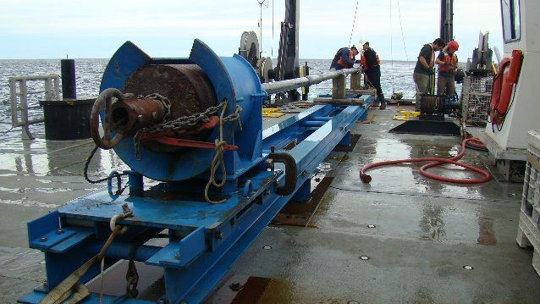
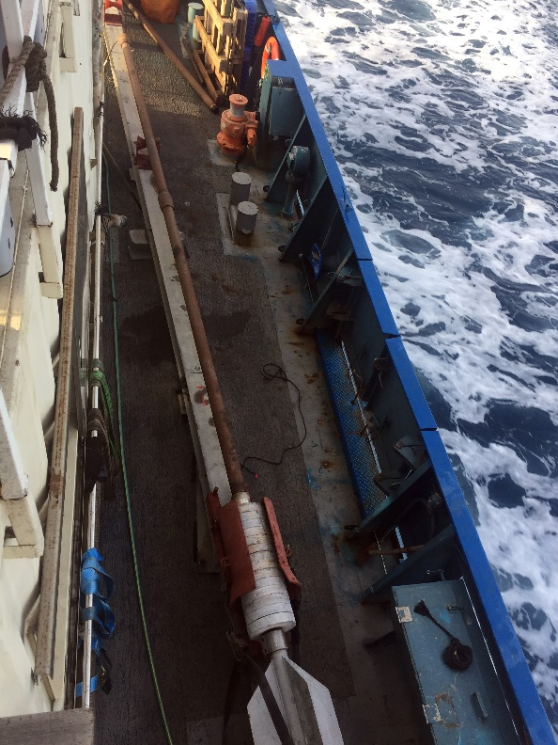
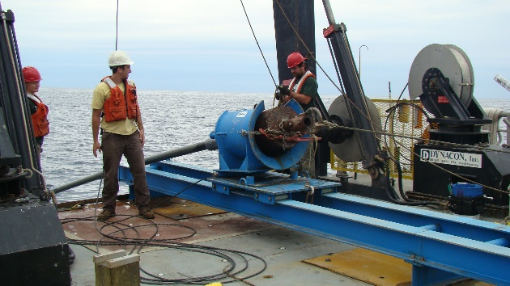
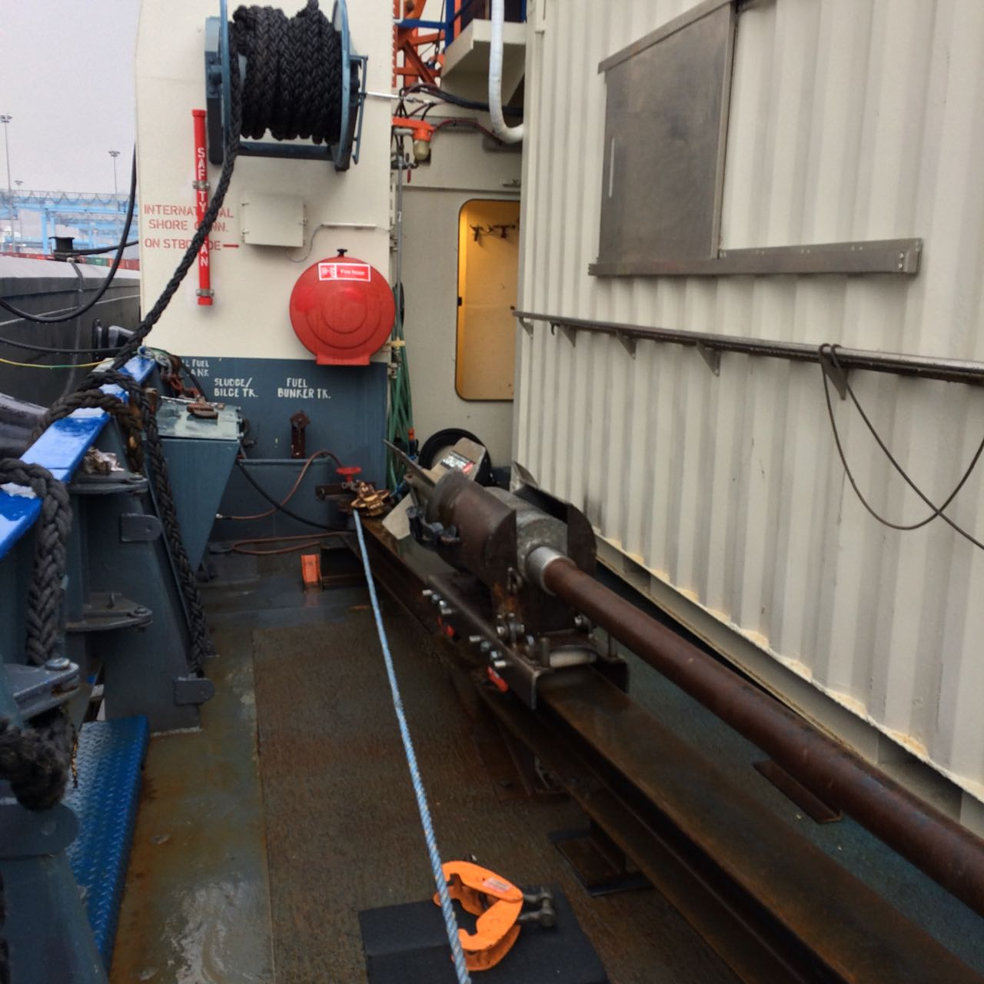
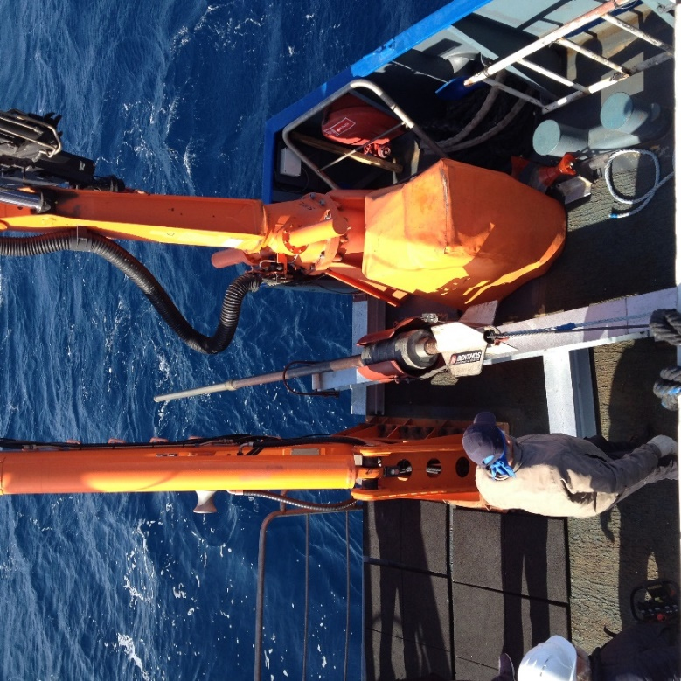
Sample the sub-bottom sediments
9 m Piston Core
Woods Hole; USGS
Box Core
6m Vibro Core

Slide 18
3-D continues current profiling
ADCP in the Gondola
Current magnitude, Training cruise offshore Hadera, June 2016 (Tal Ozer)

Slide 19
Data and sample analysis
Hydrographic lab. - Real time data acquisition & processing
Controls & operates the: navigation, multibeam, ADCP, Chirp, Camera etc.

Slide 20
Dry and wet labs
Wet Lab. ~ 18 sq.m.
Dry Lab. ~ 15 sq.m.
Isotope Lab. ~ 2.5 sq.m.

Slide 21
Remote displays & processing capabilities in each Lab. & room
Data screen bridge
In each room & Lab.:
Split data screen
High speed intranet connection to main computer to enable individual data processing
Split data screen in each room.

Slide 22
Operate & deploy autonomous and guided equipment – AUV, ROV, mooring buoy's etc.
Deploy mooring systems
USBL (LinkQuest TC5000HA)
Buoy deployment
AUV- ECA A18D: 3000m depth, synthetic-aperture-sonar (SAS), camera stereo-pair, sub-bottom profiler, obstacle avoidance system
Seaeye Leopard 3000m ROV

Slide 23
Bat Galim
spill
Oil spill response
Oil spill drill June 2016
Oil spill skimmer
Oil spill dispersant
Bat Galim control room June 2016
2 X 20’ containers with clean up equipment
Drone with FLIR
Oil spill drill October 2018

Slide 24
We hope you join us at sea as part of the EuroFleet
Special thanks for the help and advise from: Larry Mayer; Dwight Coleman; Todd Gregory; Tim Gates; Marisa Yearta; Paul Johnson; Jim Broda and Kongsberg people. IOLR: Gideon Amit ; Dani (Fritzi) Ramot; Michael Erez; Michael Epshtien; Mor Medndelson; Eldad Israeli; Tomer Keter; Mor Kanari; Tzahi Levi;
21st ERVO Annual Meeting June 11-13 , 2019 Hamburg, Germany

