Slide 1
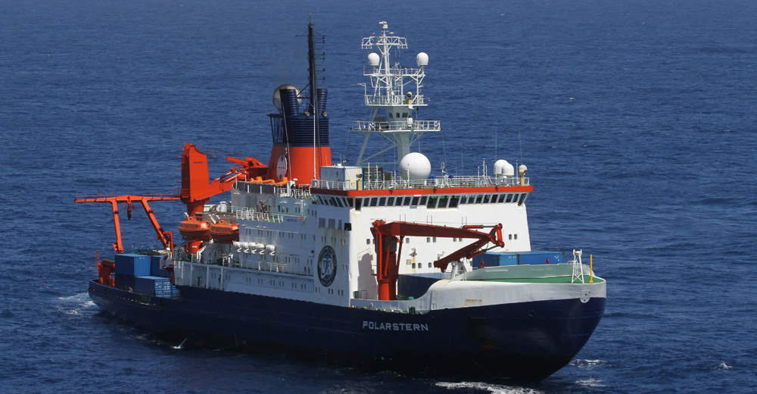
Communication in high latitudes during R/V Polarstern cruise PS122 (MOSAiC) October 2019 until September 2020
Reederei F. Laeisz

Slide 2
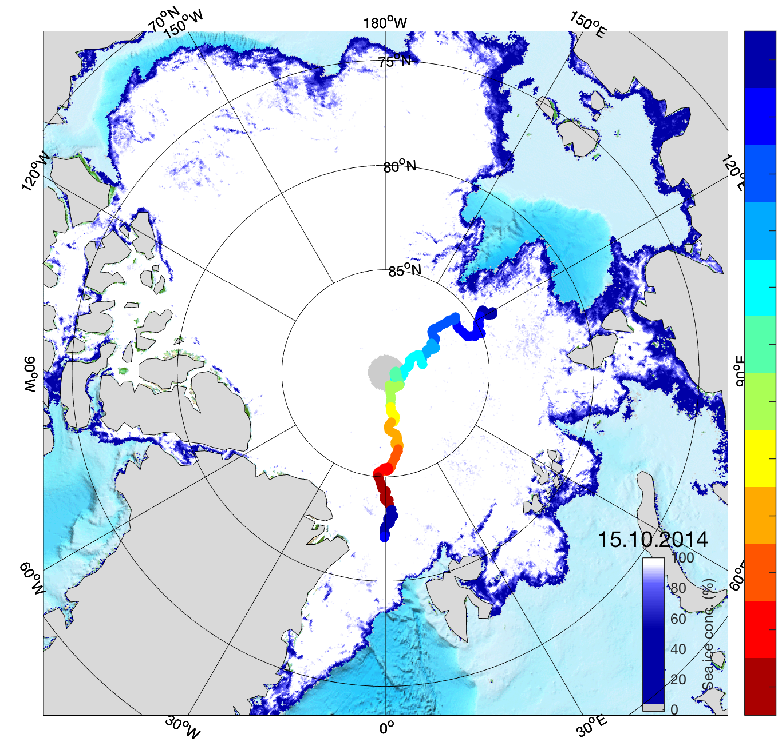
MOSAiC Drifting Project Oct. 2019 – Sept. 2020
Estimated track of R/V Polarstern
2

Slide 3
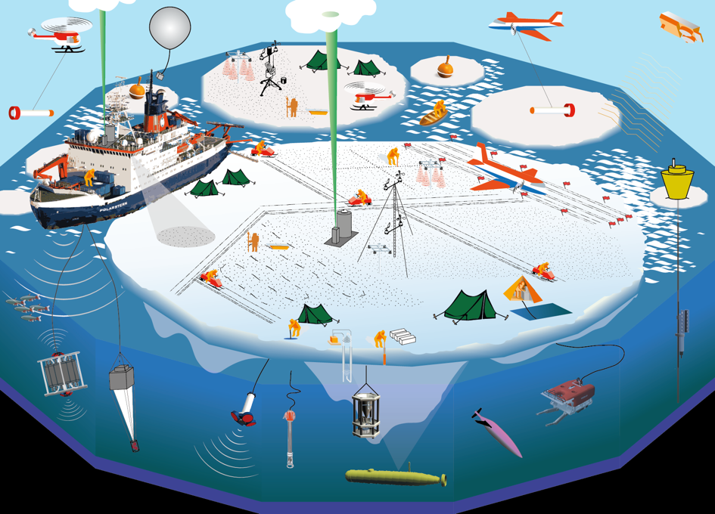
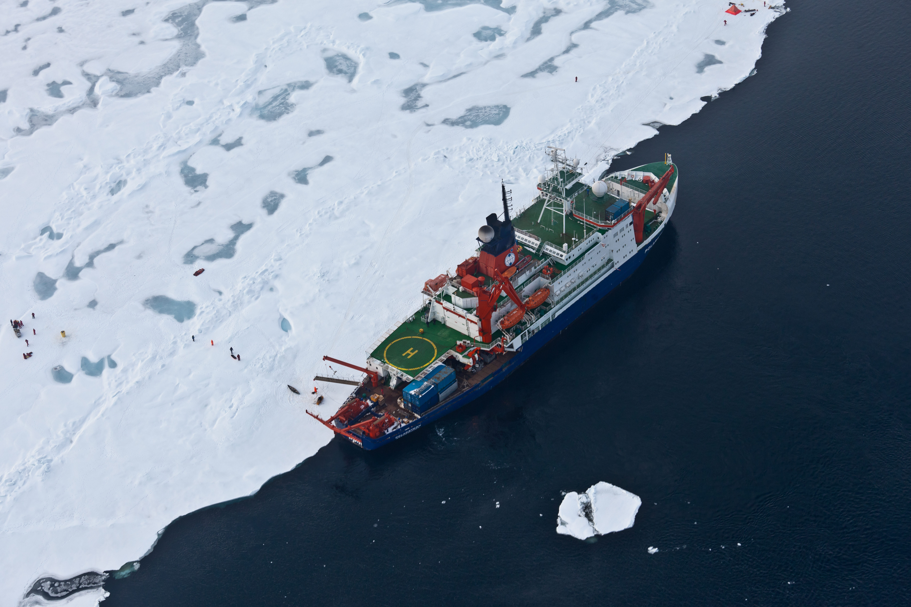
MOSAiC Drifting Experiment

Slide 4
MOSAiC Drifting Project in numbers
350 Days in the ice
Speed 7 km per day
2,500 km drift
17 nations involved
600 scientists throughout the year
150 day of polar night
-45° C lowest expected temperature
4

Slide 5
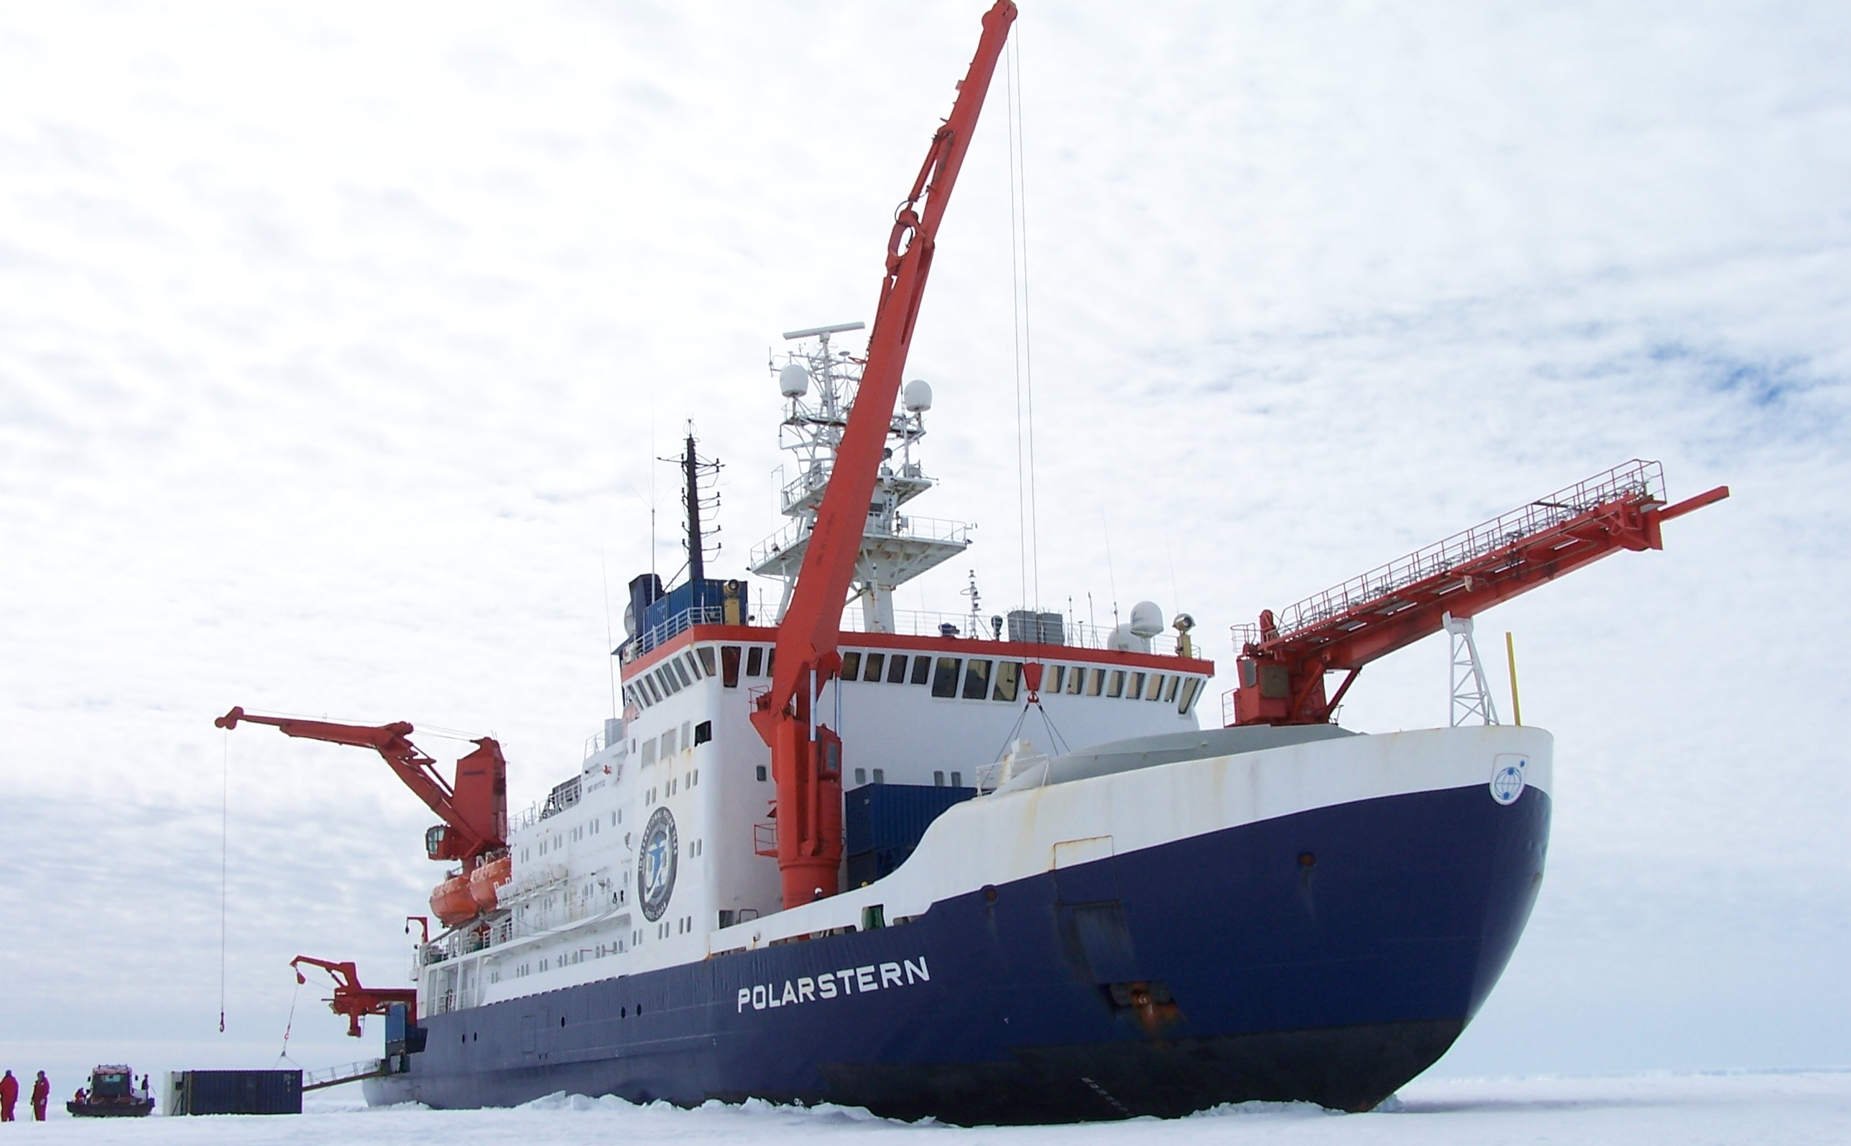
Available data communication on board Polarstern:
Inmarsat Broadband Backup of backup
VHF and UHF
Short Wave Radio (GMDSS)
Leased Line (between 75°N and 75°S) C-Band, direct line to AWI computer net
Low-Earth Orbit (Kepler) satellites High bandwidth service for bulk data transfer
Iridium Certus Backup and used in high latitudes
VSAT Ku-Band service on demand

Slide 6
R/V Polarstern
Typical data rates
Inmarsat: 240 kbit/s
Leased Line: 0,5 – 1,5 Mbit/S Up 1,0 – 2,0 Mbit/s Down
Iridium Certus: 440 kbit/s Up / Down
Iridium Pilot: 128 kbit/s Up / Down
Shortwave Paktor: 10 – 100 kbit/s
Kepler: up to 100Mbit Up / Down

Slide 7
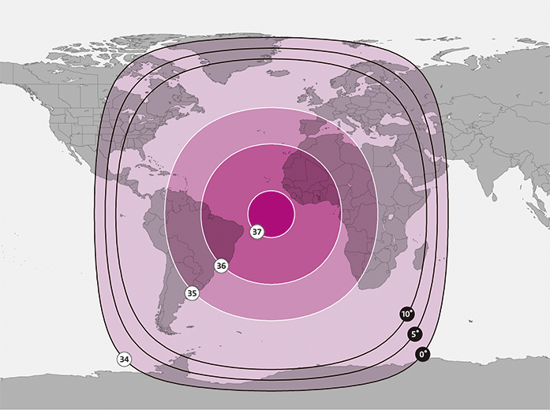
Leased Line c-Band coverage
MOSAiC
AWI
Antarctic Station Neumayer III

Slide 8
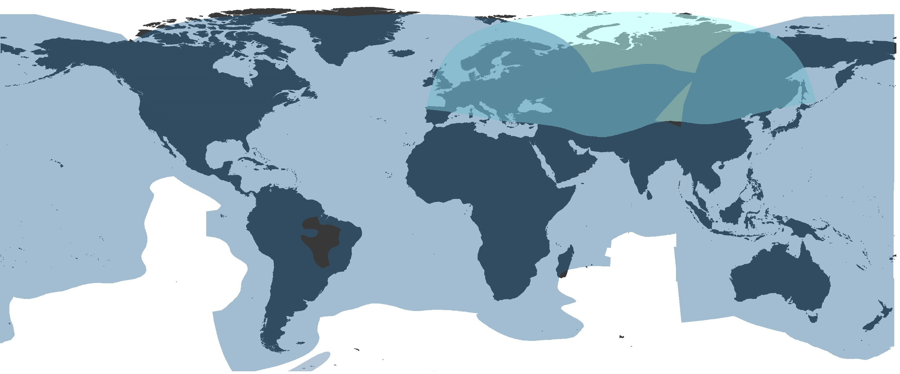
VSAT Ku-Band coverage
MOSAiC
AWI
Antarctic Station Neumayer III

Slide 9
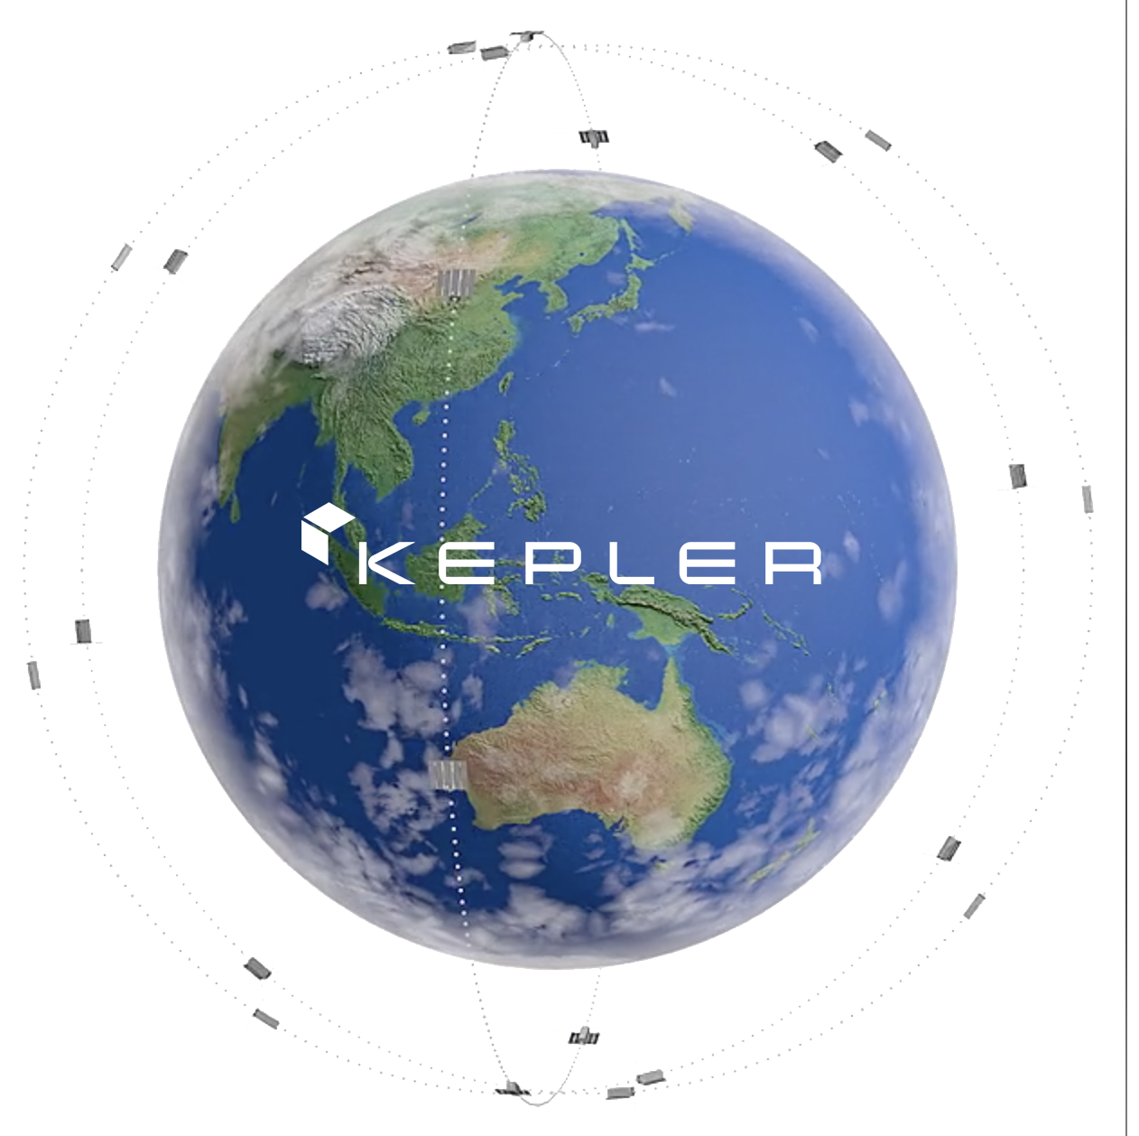
Kepler System
MOSAiC

Slide 10
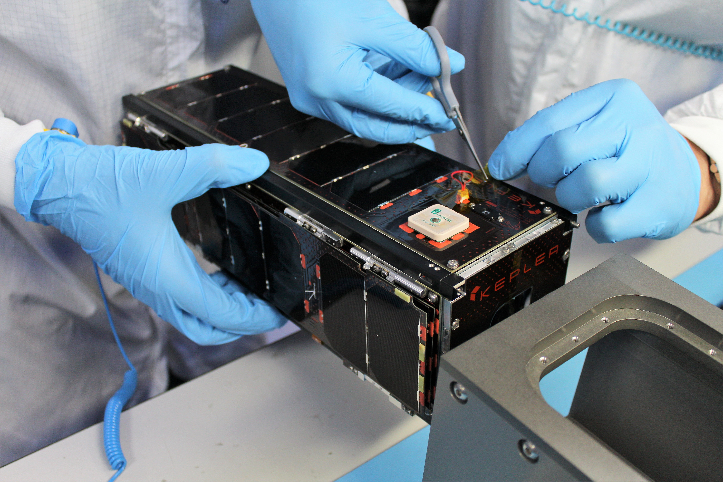
Kepler Satellites
2 Satellites in orbit (June 2019)
Altitude 575 km
140 satellites planned
5 to 10 minutes visibility per pass
Up- and download up to 100 Mbit/s with Cobham 9711 antenna

Slide 11
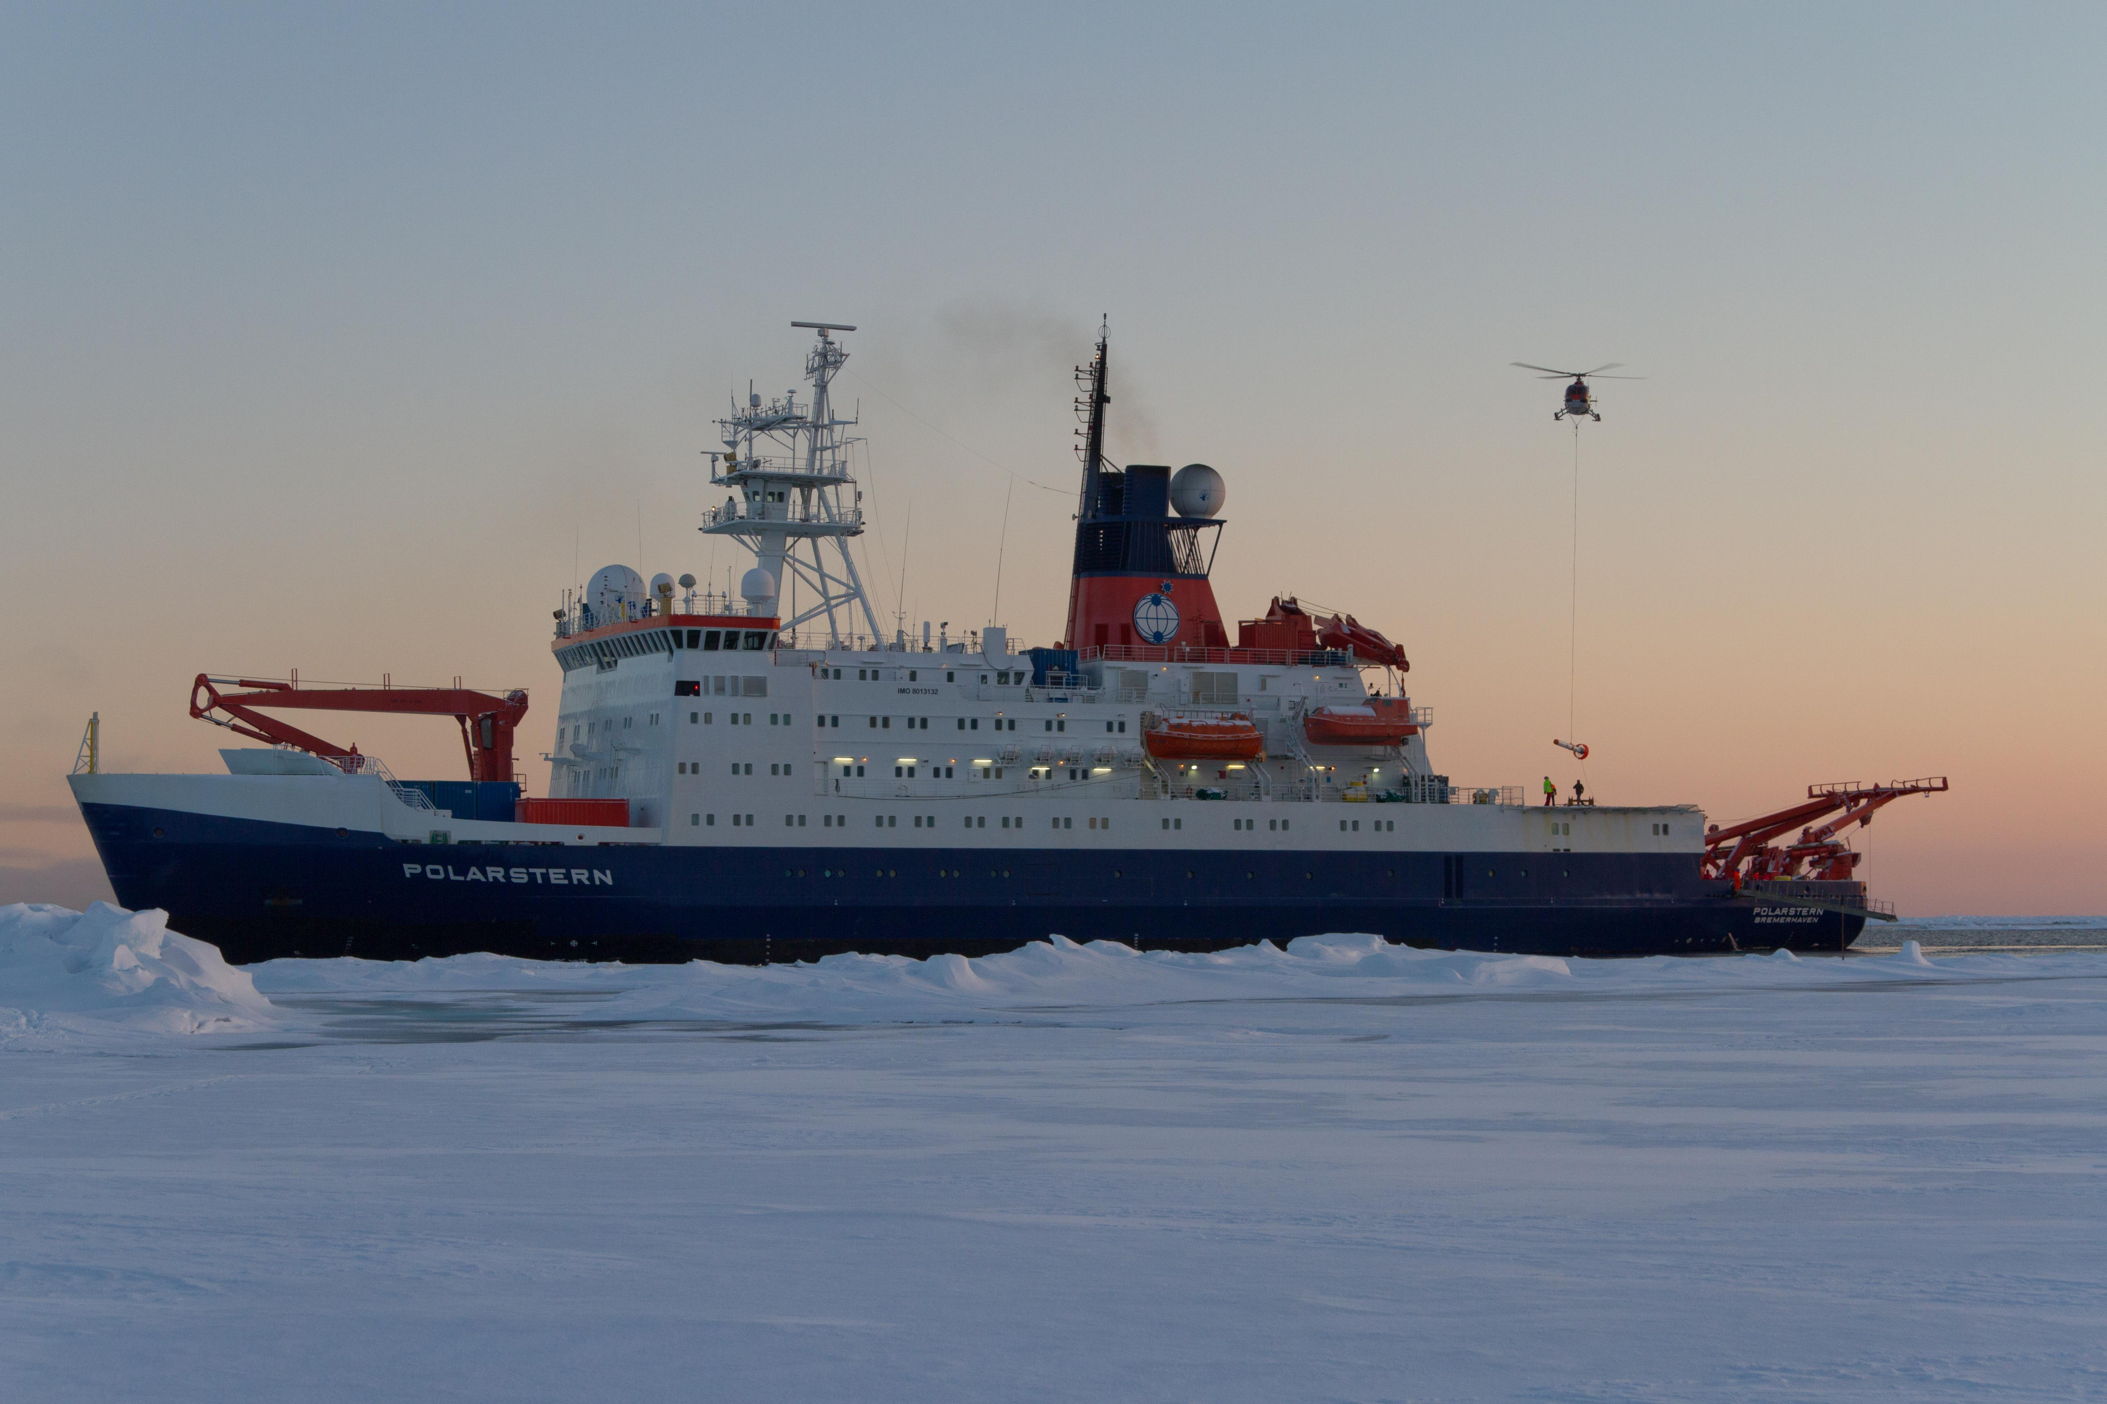
RV Polarstern
Typical use on board:
Scientific Data
Ice charts
Public outreach: pictures, videos, blogs
Video streams, both ways
E-Mail
Social Media
Browsing the Internet

Slide 12
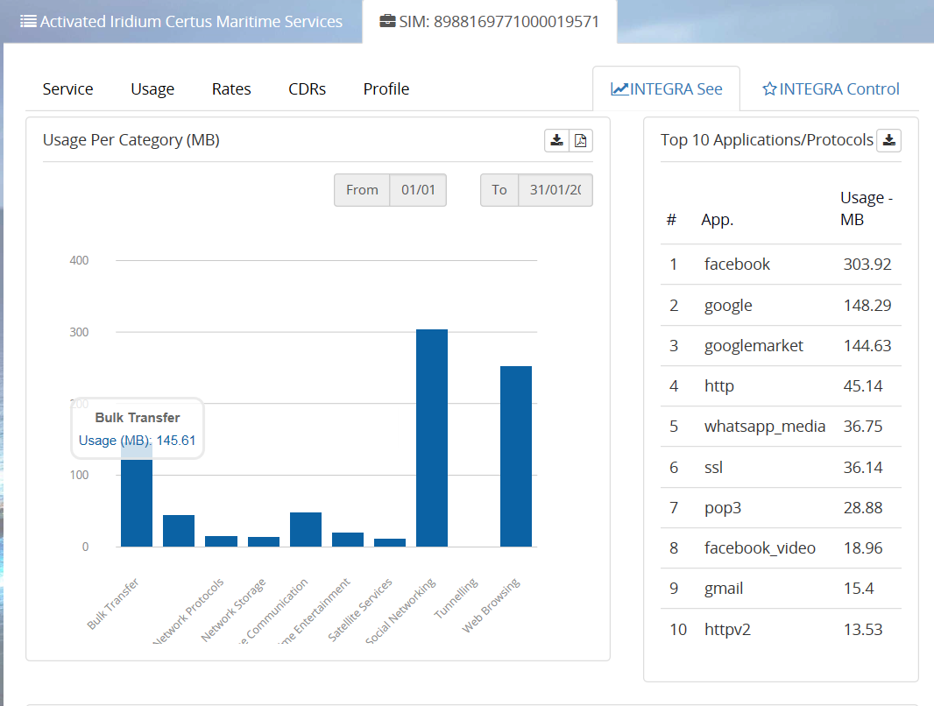
Iridium-Certus Usage in Antarctica (two days !)

Slide 13
Typical data usage:
Family of my colleague J.R. (2 adults and two teenaged kids) Speed: 100 Mbit/s Down, 40 Mbit/s Up Data: 150 – 200 GB / month
Polarstern Leased line (50 Crew and 50 Scientists) Speed: 1Mbit/s Down and up Data: approx. 100GB / month
Polarstern in norther arctic water with two iridium pilot in 2017 (50 Crew and 50 Scientists) Speed: 2 x 0.128 Mbit/s Data: 2 x 5GB / month = 10GB
MOSAiC
3 x Iridium Certus 10GB / month
Keppler Mass Data ??GB /day

Slide 14
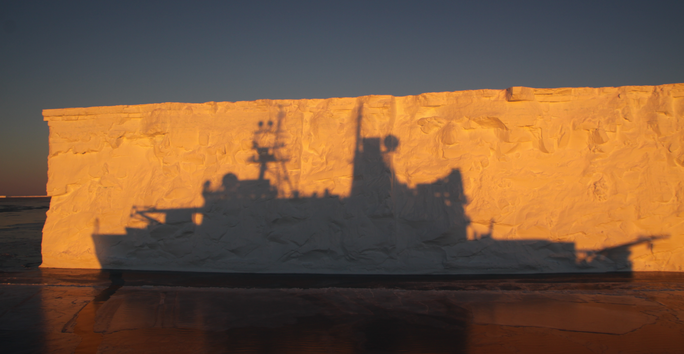
Reederei F. Laeisz
Thank you
for your Attention

